Slide 1
COMP507 IT Project Management Resource Management

Slide 2
Agenda
The Importance of Project Resource Management
Six major resource management processes:
Planning resource management
Estimating activity resources
Resource levelling
Load balancing and greedy algorithm
Acquiring resources
Developing the project team
Managing the project team
Controlling resources
Notes:
Art and science

Slide 3
The Importance of Resource Management
People determine the success and failure of organizations and projects
Most project managers agree that managing human resources effectively is one of the toughest challenges they face
Managing people is a vital component of project resource management

Slide 4
The Global IT Workforce
Although there have been ups and downs in the IT labor market, there will always be a need for good IT workers
By June of 2017, there were almost 4.3 billion mobile-broadband subscriptions
By 2020, ICT spending is projected to grow to nearly $5.5 trillion
Jobs available to IT professionals are expected to increase by 12 percent by 2024
Project management is number three on Computerworld’s hottest tech list

Slide 5
What is Project Resource Management? (1 of 2)
Making the most effective use of the human and physical resources involved with a project
Planning resource management
Estimating activity resources
Acquiring resources
Developing the project team
Managing the project team
Controlling resources

Slide 6
Keys to Managing and Leading People
Psychologists and management theorists have devoted much research and thought to the field leading people at work
Motivation theories
Influence and power
Effectiveness
Emotional intelligence
Leadership

Slide 7
Motivation Theories
Intrinsic motivation causes people to participate in an activity for their own enjoyment
Example: some people love to read, write, or play an instrument because it makes them feel good
Extrinsic motivation causes people to do something for a reward or to avoid a penalty
Example: some young children would prefer not to play an instrument, but they do because they receive a reward or avoid a punishment for doing so

Slide 8
Maslow’s Hierarchy of Needs (1 of 2)
Abraham Maslow argued that humans possess unique qualities that enable them to make independent choices, thus giving them control of their destiny
Developed a hierarchy of needs; states that people’s behaviors are guided or motivated by a sequence of needs

Slide 9
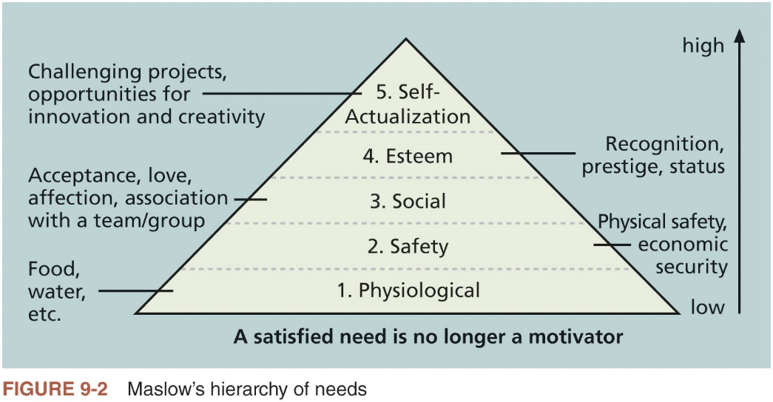
Maslow’s Hierarchy of Needs (2 of 2)

Slide 10
Herzberg’s Motivational-Hygiene Theory (1 of 2)
Frederick Herzberg distinguished between motivational factors and hygiene factors
Motivational factors: factors that cause job satisfaction
Hygiene factors: could cause job dissatisfaction

Slide 11
Herzberg’s Motivational-Hygiene Theory (2 of 2)
Hygiene Factors | Motivators
Larger salaries | Achievement
More supervision | Recognition
More attractive work environment | Work itself
Computer or other required equipment | Responsibility
Health benefits | Advancement
Training | Growth

Slide 12
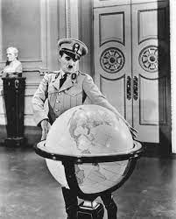
McClelland’s Acquired-Needs Theory
Specific needs are acquired or learned over time and shaped by life experiences
Achievement (nAch): achievers like challenging projects with achievable goals and regular feedback
Affiliation (nAff): people with high nAff desire harmonious relationships and need to feel accepted by others, so managers should try to create a cooperative work environment for them
Power: (nPow): people with a need for power desire either personal power (not good) or institutional power (good for the organization)

Slide 13
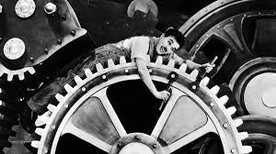
McGregor’s Theory X and Y
Douglas McGregor popularized the human relations approach to management in the 1960s
Theory X: assumes workers dislike and avoid work, so managers must use coercion, threats and various control schemes to get workers to meet objectives
Theory Y: assumes individuals consider work as natural as play or rest and enjoy the satisfaction of esteem and self-actualization needs
Theory Z: introduced in 1981 by William Ouchi and is based on the Japanese approach to motivating workers, emphasizing trust, quality, collective decision making, and cultural values

Slide 14
Influence and Power (1 of 3)
Thamhain and Wilemon: ways to have influence on projects
Authority: legitimate hierarchical right to issue orders
Assignment: ability to influence a worker's later work assignments
Budget: ability to authorize others' use of discretionary funds
Promotion: ability to improve a worker's position
Money: ability to increase a worker's pay and benefits
Penalty: ability to cause punishment
Work challenge: ability to assign work that capitalizes on a worker's enjoyment of doing a particular task
Expertise: perceived special knowledge that others deem important
Friendship: ability to establish friendly personal relationships between the project manager and others

Slide 15
Influence and Power (2 of 3)
Ways to influence
Project managers who use work challenges and expertise to influence people projects are more likely to succeed
Projects are more likely to fail when project managers rely too heavily on authority, money, or penalty

Slide 16
Influence and Power (3 of 3)
Power is the potential ability to influence behavior to get people to do things they would not otherwise do
Types of power
Coercive
Legitimate
Expert
Reward
Referent (role model)

Slide 17
Covey and Improving Effectiveness (1 of 2)
Project managers can apply Covey’s seven habits to improve effectiveness on projects
Be proactive
Begin with the end in mind (have a clear vision)
Put first things first
Think win/win
Seek first to understand, then to be understood
Synergize
Sharpen the saw

Slide 18
Covey and Improving Effectiveness (2 of 2)
Good project managers are empathic listeners
They listen with the intent to understand
Before you can communicate with others, you have to have rapport
Relation of harmony, conformity, accord, or affinity
Mirroring is the matching of certain behaviors of the other person
A technique to help establish rapport
IT professionals need to develop empathic listening and other people skills to improve relationships with users and other stakeholders

Slide 19
Emotional Intelligence
Howard Gardner’s book Frames of Mind: The Theory of Multiple Intelligences introduced the concept of using more than one way to think of and measure human intelligence
Emotional intelligence (EI) is knowing and managing one’s own emotions and understanding the emotions of others for improved performance

Slide 20
Developing the Resource Management Plan and Team Charter
Involves identifying and documenting project resources, roles, responsibilities, skills, and reporting relationships
Can be separated into a human resource management plan and a physical resource management plan
Contents include:
Project organizational charts
Responsibility assignment matrixes
Staffing management plan and resource histograms
Team charters

Slide 21
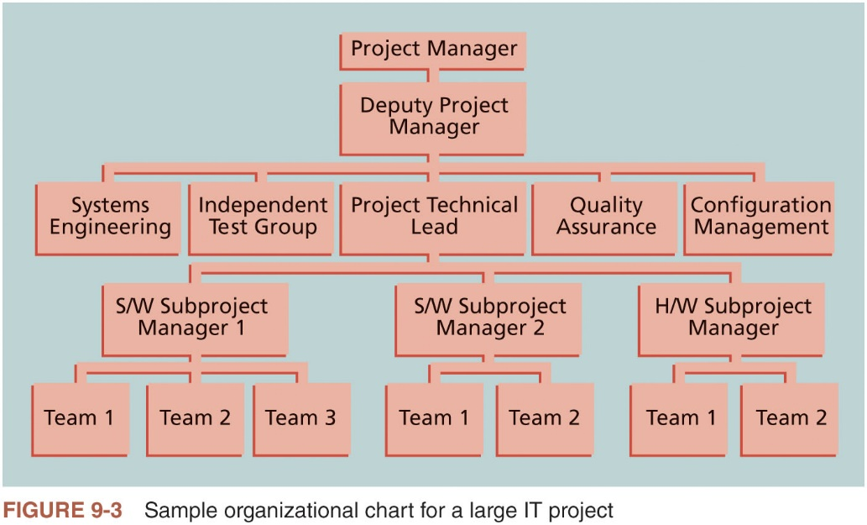
organizational charts

Slide 22
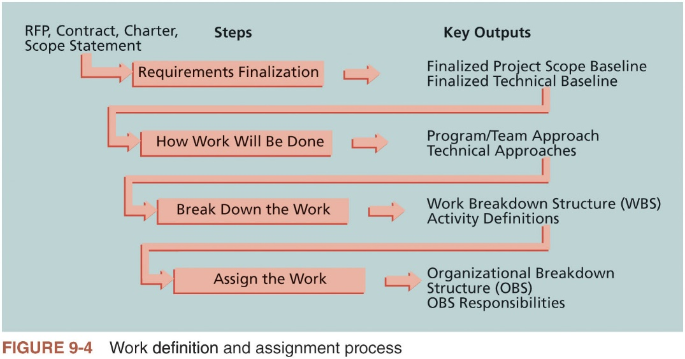
Assignment workflow

Slide 23
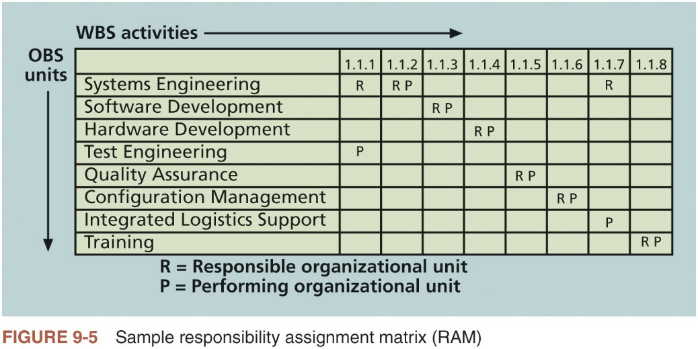
Responsibility assignment matrixes

Slide 24
RACI (Responsibility, Accountability, Consultation, Informed) chart
 | Car Owner | Shop Owner | Mechanic | Parts Supplier
Pay for parts and services | A, R | C
Determine parts and services needed | C |  | A, R | C
Supply parts |  | C | C | A, R
Install parts | I | A | R
Table 9-2 Sample RACI chart

Slide 25
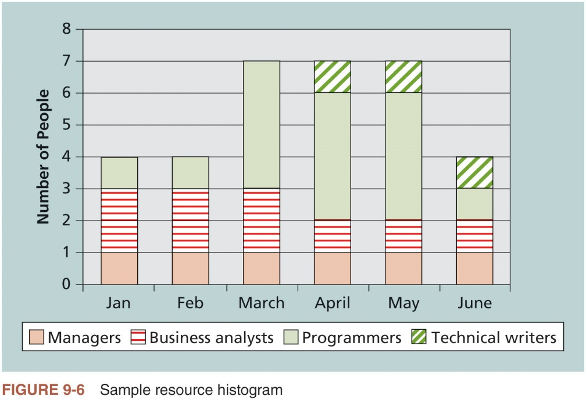
Resource histogram

Slide 26
Estimating Activity Resources
Tools that can assist in resource estimating
Expert judgment
Various estimating approaches
Data analysis
Project management software
Meetings

Slide 27
Resource Loading (1 of 2)
Resource loading refers to the amount of individual resources an existing schedule requires during specific time periods
Helps project managers develop a general understanding of the demands a project will make on the organization’s resources and individual people’s schedules
A resource is said to be overallocated when he/she is assigned more work than the actual capacity within a given time.

Slide 28
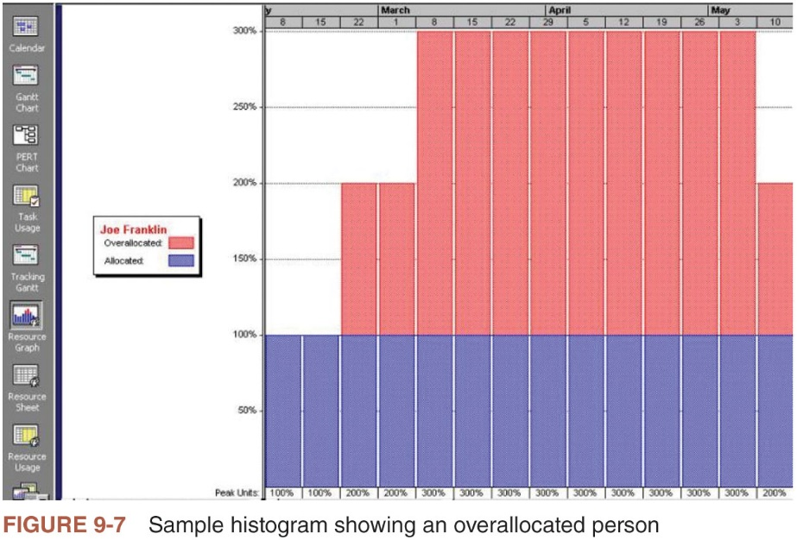
Resource Loading (2 of 2)

Slide 29
Resource Leveling (1 of 2)
Resource leveling is a technique for resolving resource conflicts by delaying tasks
Main purpose is to create a smoother distribution of resource usage
Benefits of resource leveling
When resources are used on a more constant basis, they require less management
May enable project managers to use a just-in-time inventory type of policy for using subcontractors or other expensive resources
Results in fewer problems for project personnel and accounting department
Often improves morale

Slide 30
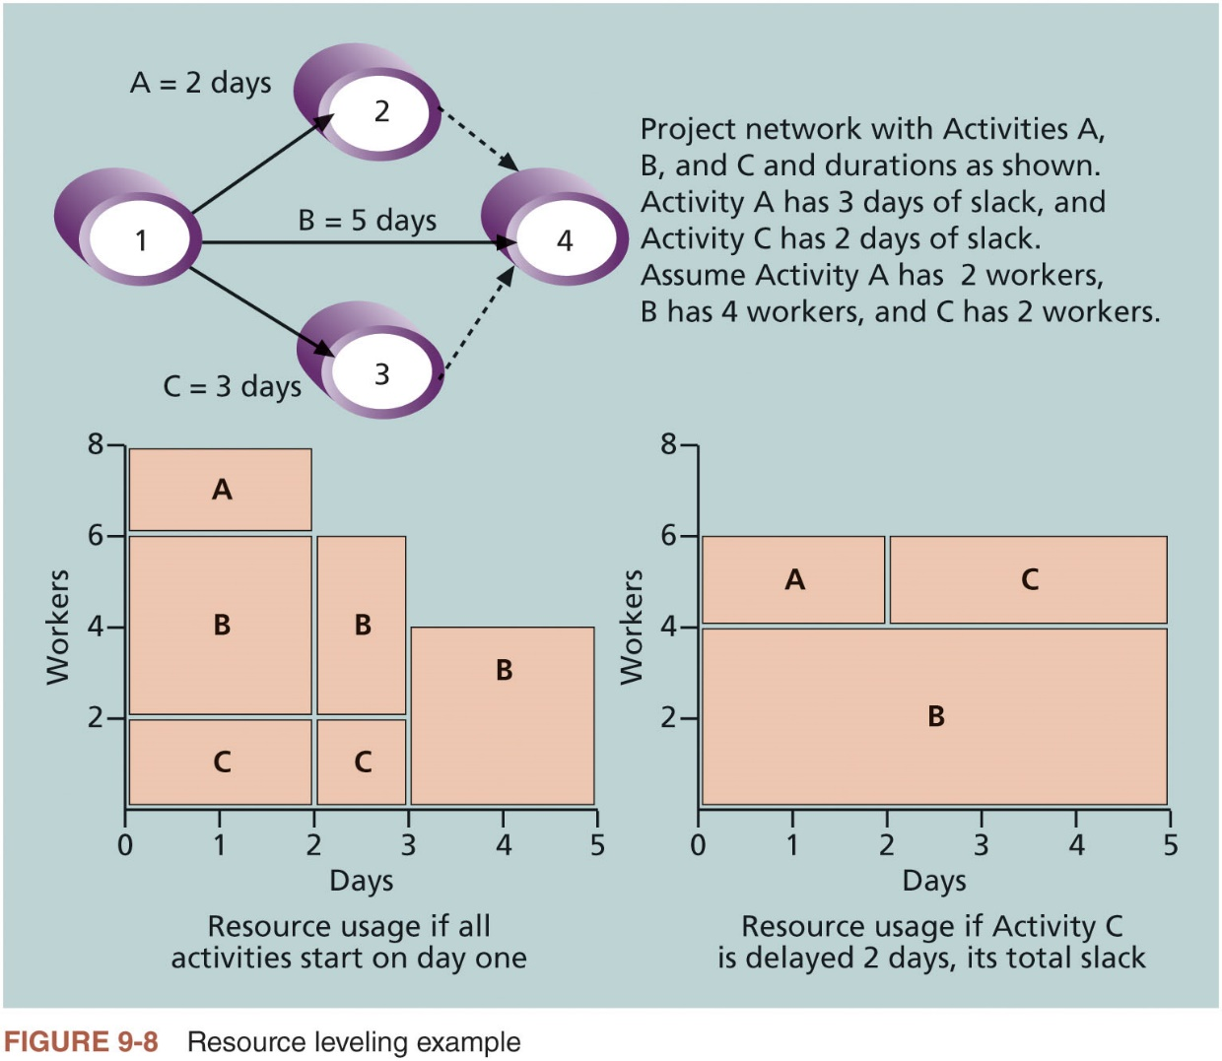
Resource Leveling (2 of 2)

Slide 31
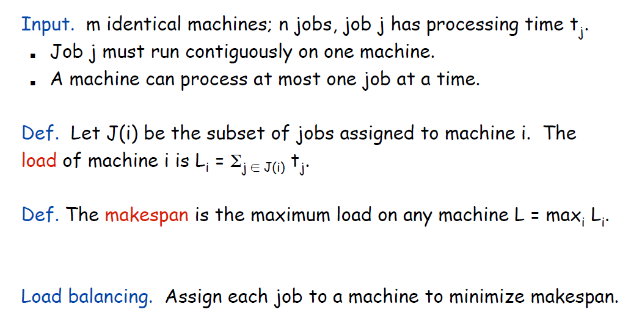
Load Balancing
J. Kleinberg and E. Tardos, Algorithm Design, Person-Addison Wesley.

Slide 32
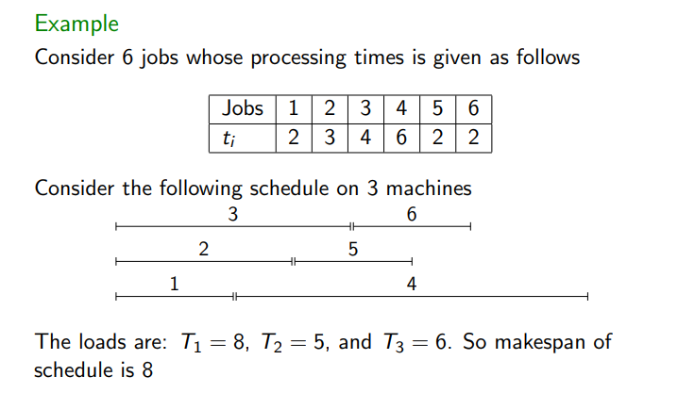
Example
Can you find the optimal makespan L*?
https://www.otfried.org/courses/cs500/slides-approx.pdf

Slide 33
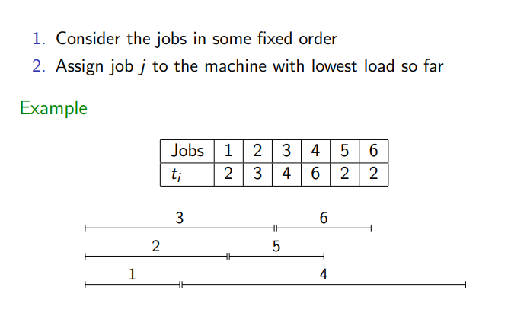
Greedy Algorithm

Slide 34
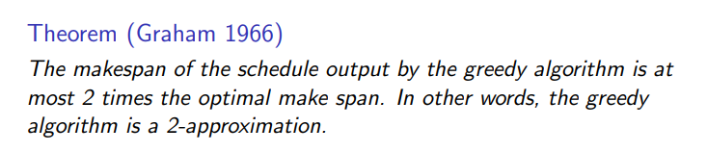
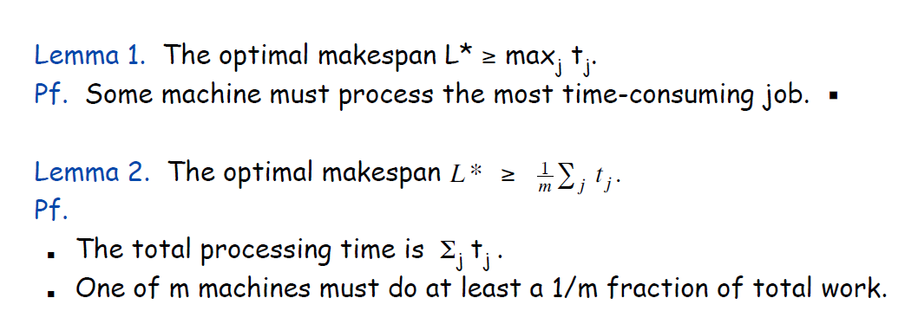
Greedy algorithm analysis

Slide 35
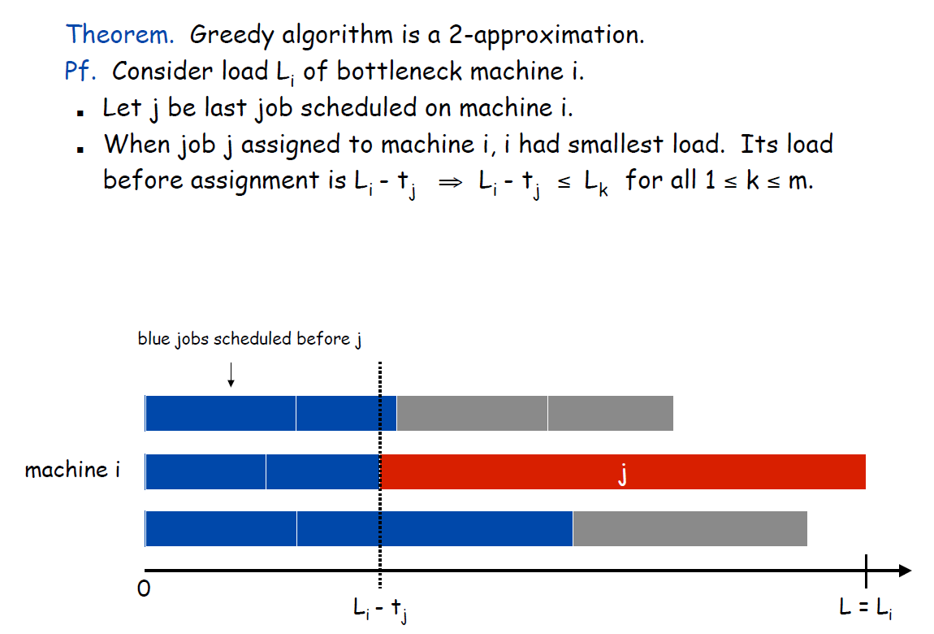
Greedy algorithm analysis

Slide 36
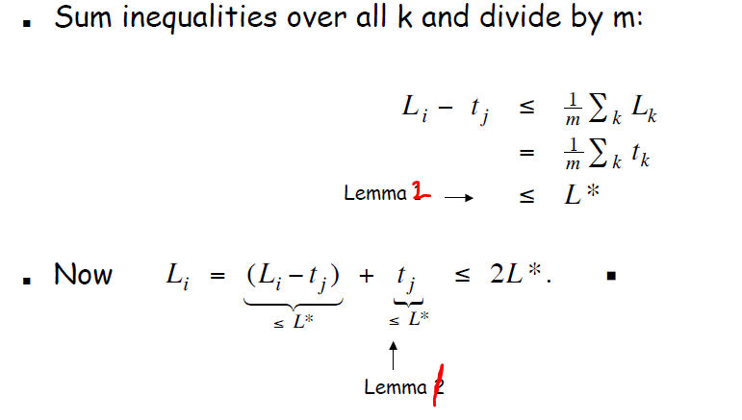
Greedy algorithm analysis

Slide 37
Developing the Project Team (1 of 2)
The main goal of team development is to help people work together more effectively to improve project performance
It takes teamwork to successfully complete most projects
Tuckman model describes five stages of team development
Forming
Storming
Norming
Performing
Adjourning

Slide 38
Developing the Project Team (2 of 2)
Training
Project managers often recommend that people take specific training courses to improve individual and team development
Team-building activities
Physical challenges
Psychological preference indicator tools

Slide 39
The Meyers-Briggs Type Indicator
Popular tool for determining personality preferences and helping teammates understand each other
Four dimensions
Extrovert/Introvert (E/I)
Sensation/Intuition (S/N)
Thinking/Feeling (T/F)
Judgment/Perception (J/P)
Intuitive/Thinking types (i.e., NTs or rationals) are attracted to technology fields

Slide 40
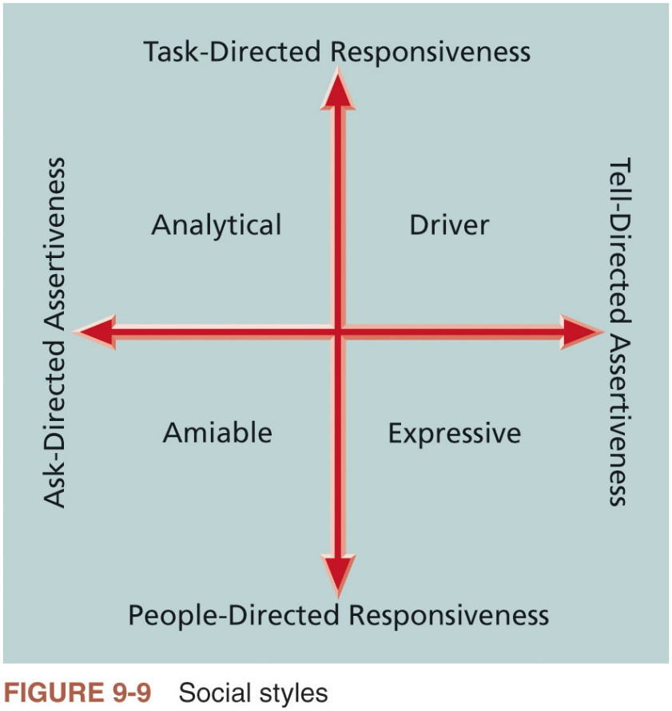
The Social Styles Profile
People are perceived as behaving primarily in one of four zones, based on their assertiveness and responsiveness
Drivers
Expressives
Analyticals
Amiables

Slide 41
Reward and Recognition Systems
Team-based reward and recognition systems can promote teamwork
Focus on rewarding teams for achieving specific goals
If management rewards teamwork, they will promote or reinforce the philosophy that people work more effectively in teams
Project managers must continually assess their team’s performance
When they find areas in which individuals or the entire team can improve, it’s their job to find the best way to develop their people and improve performance

Slide 42
Tools and Techniques for Managing Project Teams (1 of 4)
Several tools and techniques are available to assist in managing project teams
Interpersonal and team skills
Project management information systems
Conflict management

Slide 43
Tools and Techniques for Managing Project Teams (2 of 4)
Conflict handling modes
Confrontation: directly face a conflict using a problem-solving approach
Compromise: use a give-and-take approach
Smoothing: de-emphasize areas of difference and emphasize areas of agreement
Forcing: win-lose approach
Withdrawal: retreat or withdraw from an actual or potential disagreement
Collaborating: decision makers incorporate different viewpoints and insights to develop consensus and commitment

Slide 44
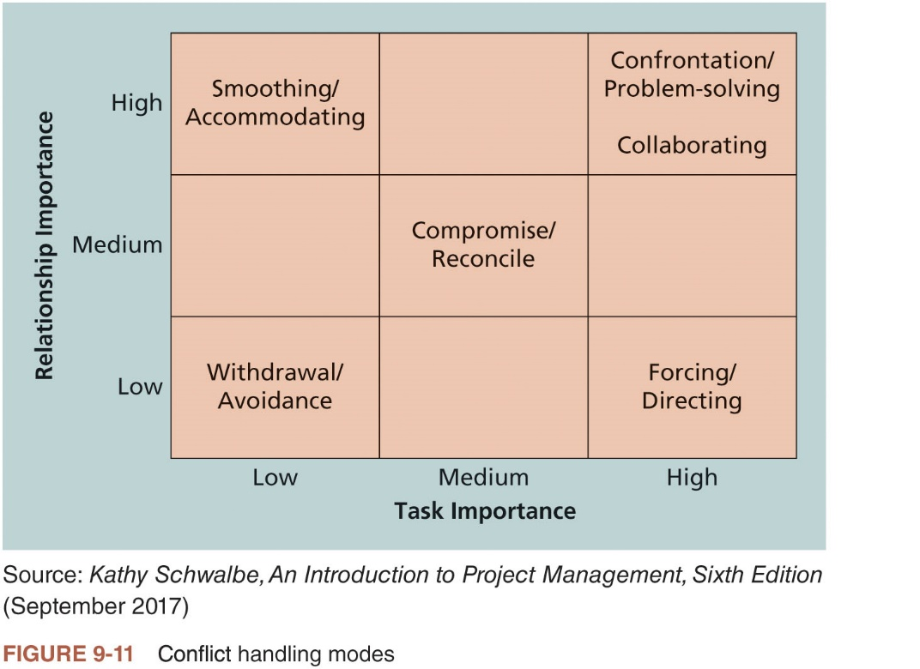
Tools and Techniques for Managing Project Teams (3 of 4)

Slide 45
Tools and Techniques for Managing Project Teams (4 of 4)
Conflict can be good
Conflict often produces important results, such as new ideas, better alternatives, and motivation to work harder and more collaboratively
Groupthink: conformance to the values or ethical standards of a group; can develop if there are no conflicting viewpoints
Research suggests that task-related conflict often improves team performance, but emotional conflict often depresses team performance

Slide 46
General Advice on Managing Teams
General advice
Be patient and kind with your team
Fix the problem instead of blaming people
Establish regular, effective meetings
Allow time for teams to go through the basic team-building stages
Limit the size of work teams to three to seven members
Plan some social activities to help project team members and other stakeholders get to know each other better
Stress team identity
Nurture team members and encourage them to help each other
Acknowledge individual and group accomplishments
Take additional actions to work with virtual team members

Slide 47
Controlling Resources
Ensuring physical resources assigned to the project are available as planned
Also involves monitoring the planned versus actual resources utilization and taking corrective actions as needed

